Slide 1
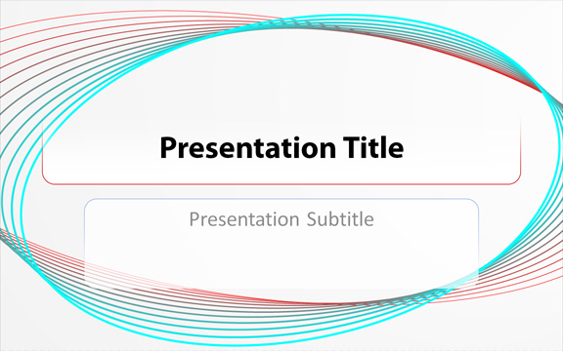
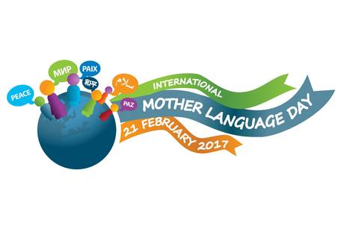
UNESCO celebrates International Mother Language Day (IMLD) on February 21, 2017 under the theme “Towards Sustainable Futures through Multilingual Education”. To foster sustainable development, learners must have access to education in their mother tongue and in other languages. It is through the mastery of the first language or mother tongue that the basic skills of reading, writing and numeracy are acquired. Local languages, especially minority and indigenous, transmit cultures, values and traditional knowledge, thus playing an important role in promoting sustainable futures.

Slide 2
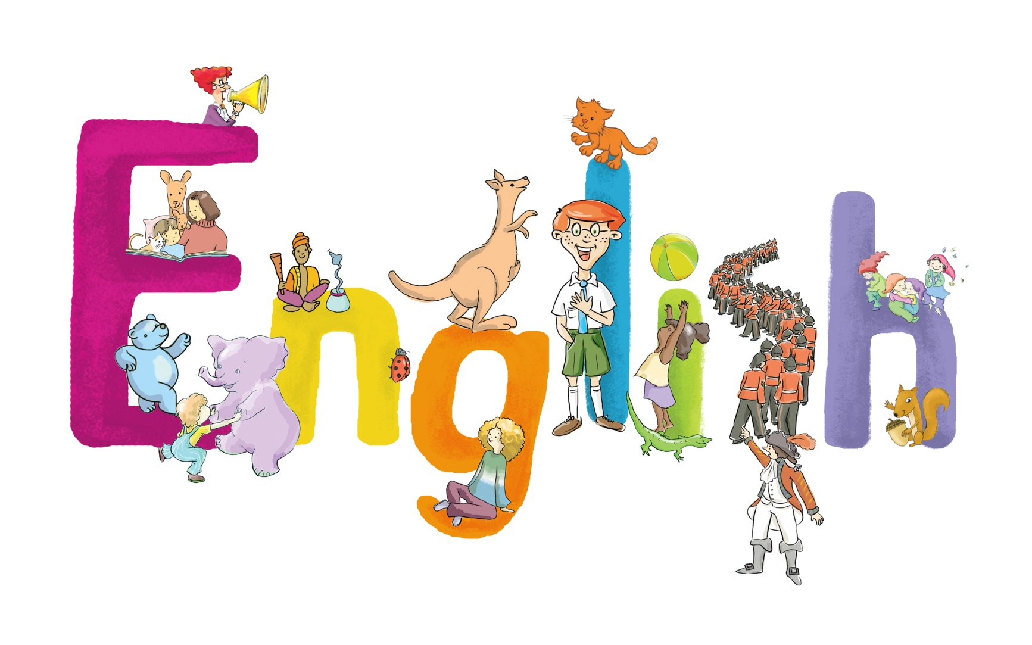

Slide 3

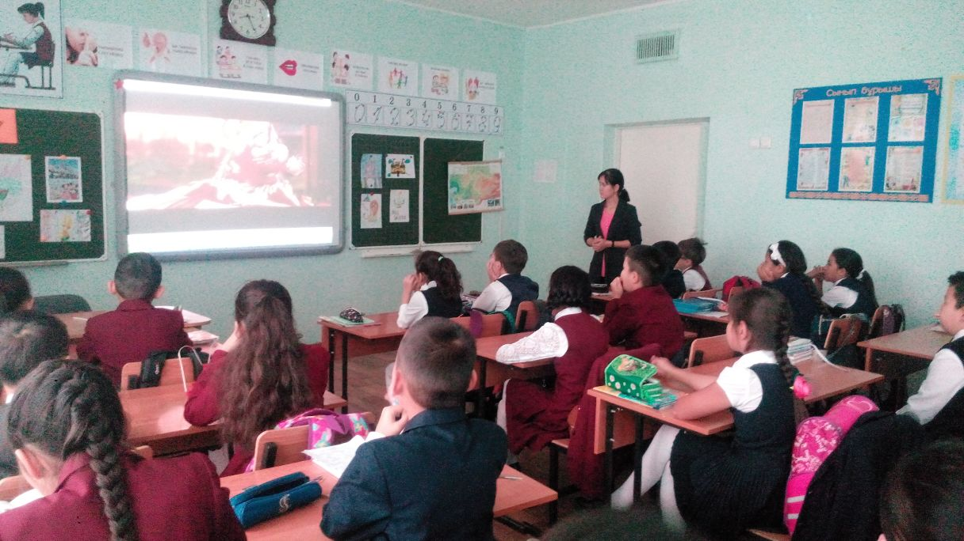
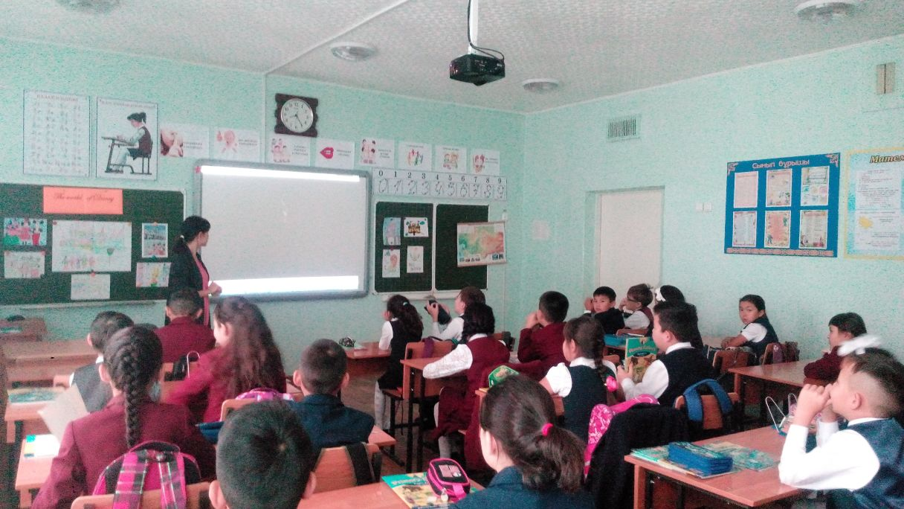
“The World of Disney”
Form 4, participated 29 pupils

Slide 4

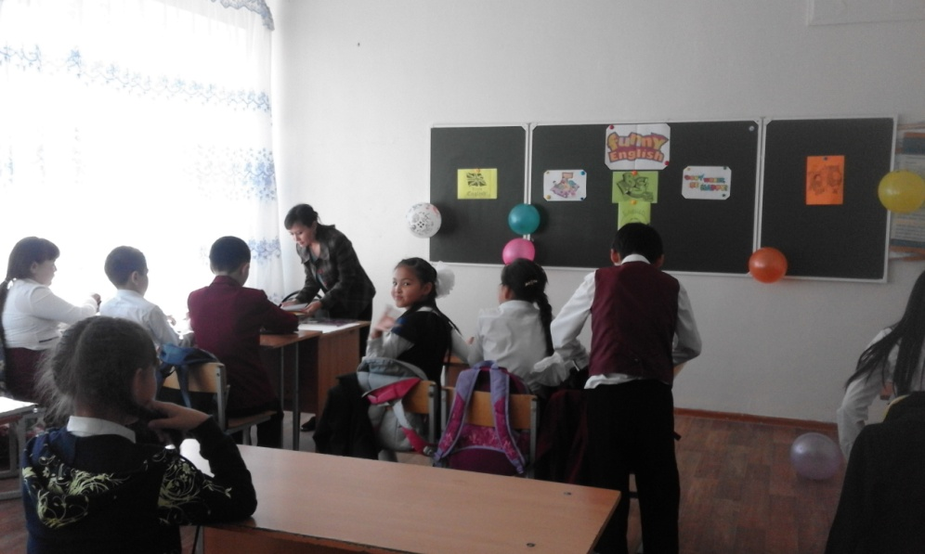
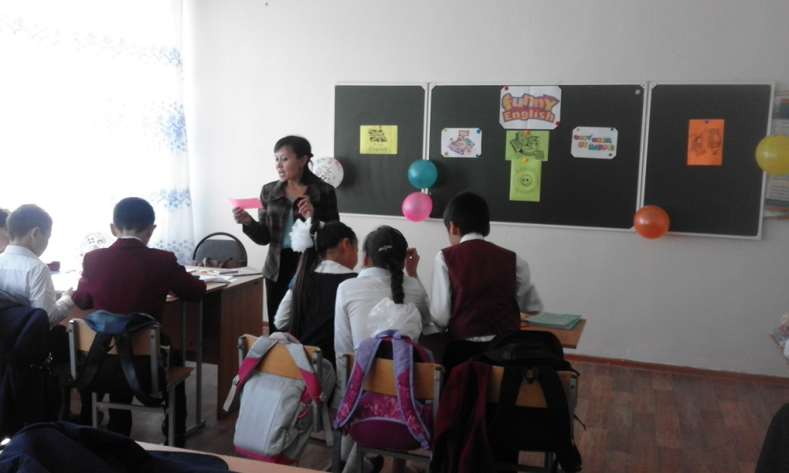
“Funny English” competition
Form 5, participated 20 pupils

